Slide 1

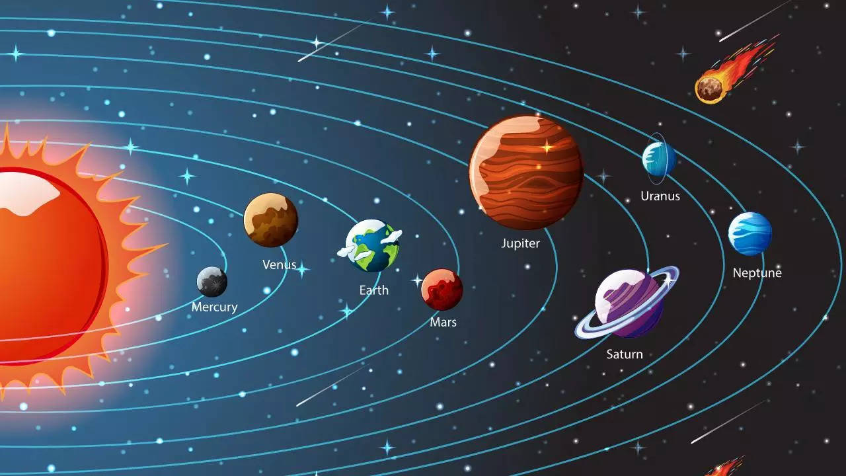
Today
About

Slide 2

Solar System => “Solar” =>” Solis” (Sun in Latin)
Situated in Milky-way Galaxy’s Orion Arm / Orion Spur, between two major arm Sagittarius & Perseus.
Orion arm is of 2 to 4 light years in diameter.
Orbit around center of galaxy at 8,28,000km/h for about 230million years.
27,000 light years away from galactic center.
Solar system live

Slide 3
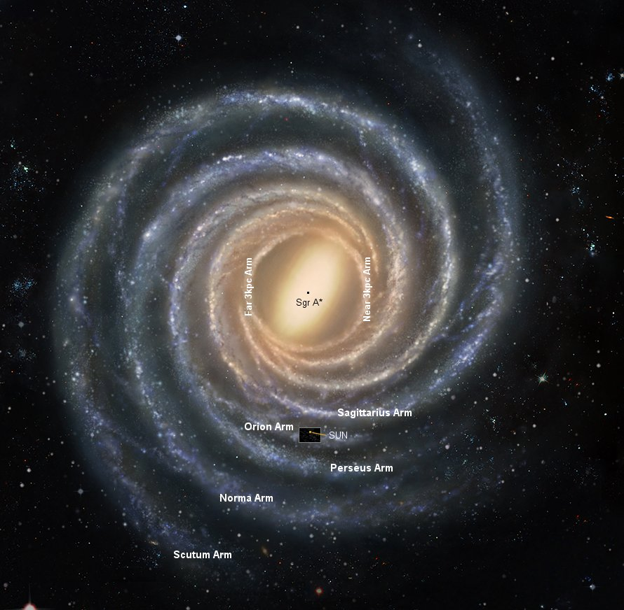
Where are we in galaxy……..

Slide 4
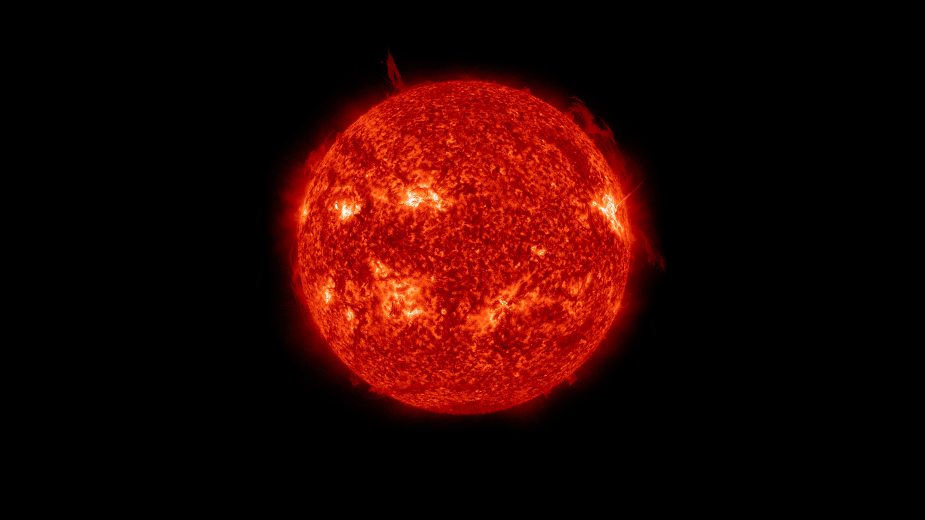
Bonding Manager

Slide 5

Center of our system.
Sun’s gravity field holds our system which is about 274m/s².
Heliophysics => study of sun.
G2V => scientific name of our sun.
Radius of 7,00,000km.
The fact that our Sun and the stars all have similar compositions and are made up of mostly hydrogen and helium was first shown in a brilliant thesis in 1925 by Cecilia Payne-Gaposchkin, the first woman to get a PhD in astronomy in the United States

Slide 6
Element | Abundance (pct. of total number of atoms) | Abundance (pct. of total mass)
Hydrogen | 91.2 | 71.0
Helium | 8.7 | 27.1
Oxygen | 0.078 | 0.97
Carbon | 0.043 | 0.40
Nitrogen | 0.0088 | 0.096
Silicon | 0.0045 | 0.099
Magnesium | 0.0038 | 0.076
Neon | 0.0035 | 0.058
Iron | 0.030 | 0.014
Sulfur | 0.015 | 0.040

Slide 7
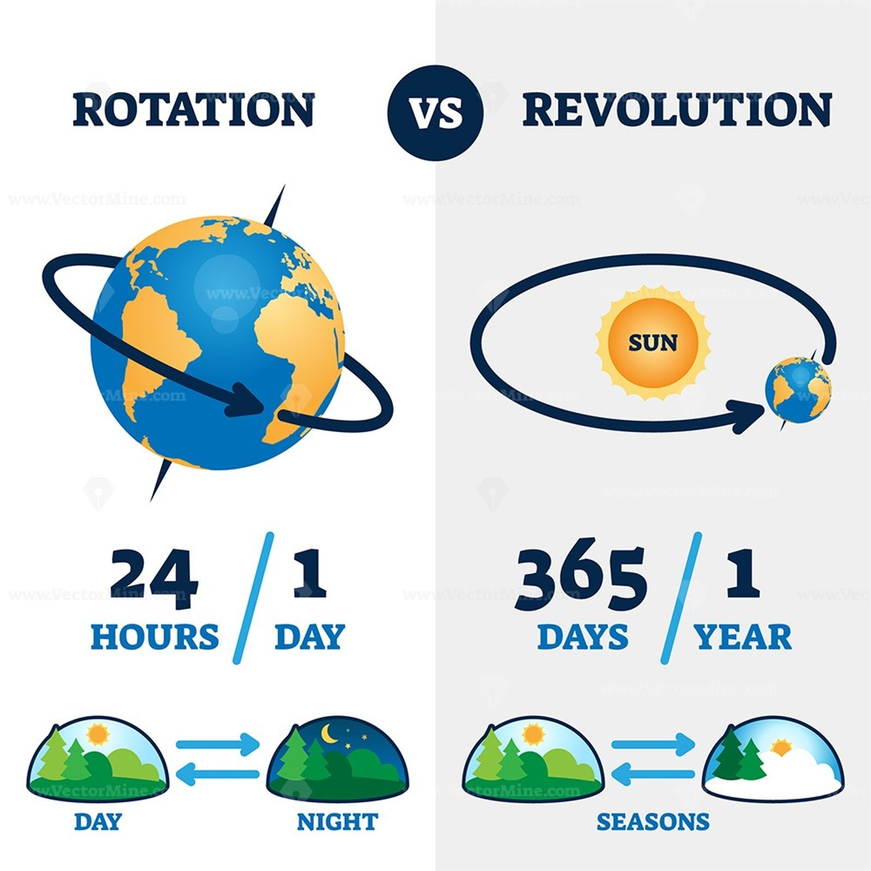

Slide 8
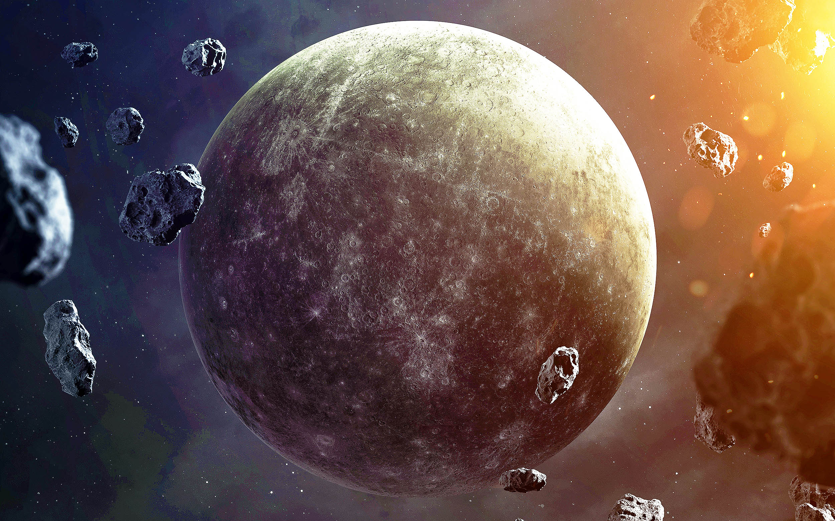
Speedster

Slide 9


Closest to Sun.
Roman God Mercury who was swift messenger.
Diameter of 4,879.4km; Mass 3.30 x 10²³kg.
Gravity acceleration of 3.7m/s².
88 days for orbital rotation (revolution) ; 5,79,10,000 km from sun.
Day length of 58 earth days (rotation).
Temp: -173ºC at night; 427ºC at day.
Around 47.87 km/s orbital speed.
Terrestrial planet; Core => Iron (liquid & solid); Mantle => Silicon; Crust => Silicon.
Water in ice form as low atmospheric pressure.
Weak magnetic and gravity field.

Slide 10
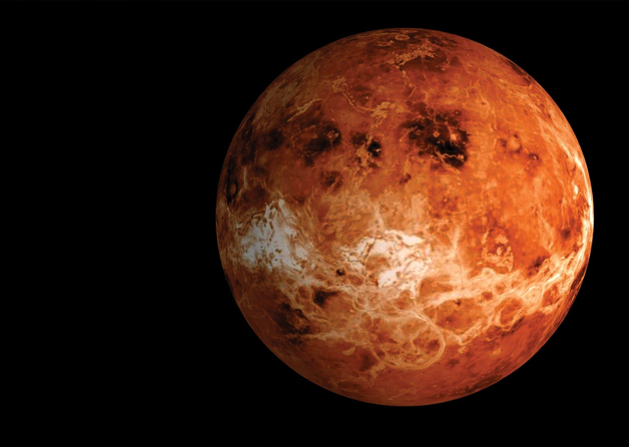
Hottest

Slide 11


Densest planet; 10,82,00,000 km from sun.
Diameter of 12,104km; Temperature of 462ºC.
Acceleration due to gravity is 8.87m/s².
Day length of 243 earth days.
Orbital time of 225 earth days in the speed of 35.02km/s in opposite direction.
Name from Roman god of love and beauty.
Atmosphere: 96.5% of CO2.

Slide 12
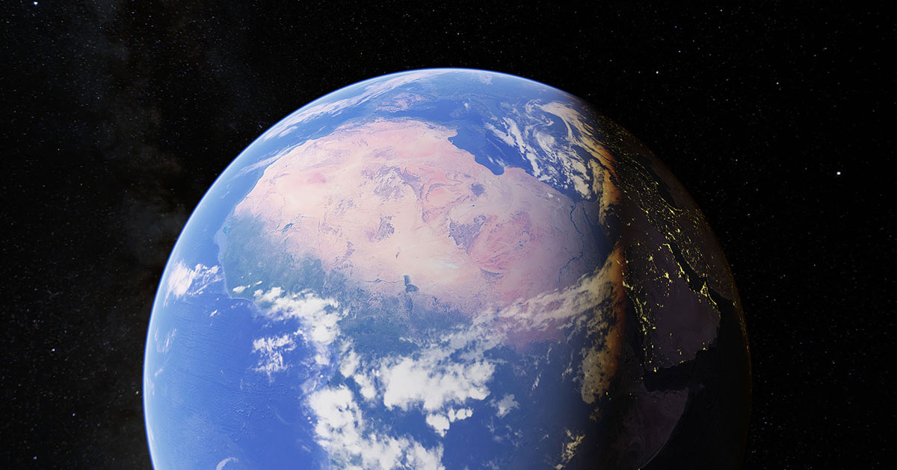

Slide 13

Fifth largest. Earth => English word mean soil or ground.
Habitable Planet; Three Layers – Core, Mantel, Lithosphere.
Geoid shape; 12,760 km of diameter; 15,00,00,000 km from sun (1AU).
Gravity acceleration is 9.8m/s².
Atmosphere: 78% nitrogen, 21% oxygen, 1% others.
Strong magnetic field and perfect gravity field.
About 100 to 150 crore years earth become inhabitable planet.
Live earth

Slide 14

Goldilocks Zone
Habitable zone.
Water stay as liquid in this planet.
0.95AU to 1.7AU in our solar system.
Earth lies in the zone where Venus in inner edge and mars at outer edge.
Habitable Zone not fixed.
Expand or Compress with star property of luminous and heat.

Slide 15
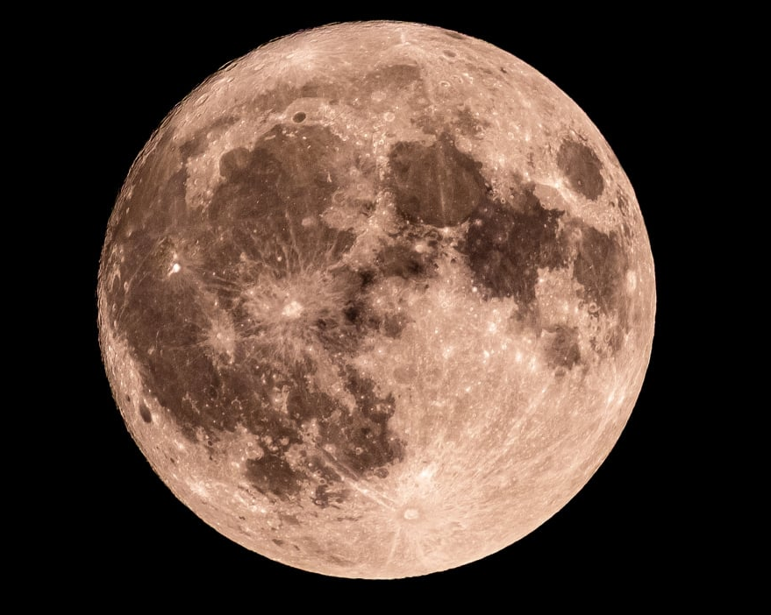

Slide 16
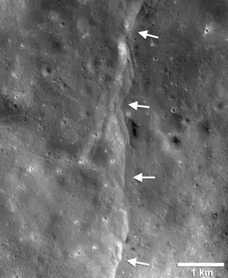
Closest to us; 3475km of diameter; 3,82,500km distance.
Gravity of 1.6 m/s².
Temperature: day 273°F (134°C) and night 243°F (-153°C).
Control Water motion and Climate and Angle of drift.
Moon View.

Slide 17
Elements | Percentage %
Oxygen | 43
Silicon | 20
Magnesium | 19
Iron | 10
Aluminum | 3
Chromium | 0.42
Titanium | 0.18
Manganese | 0.12

Slide 18
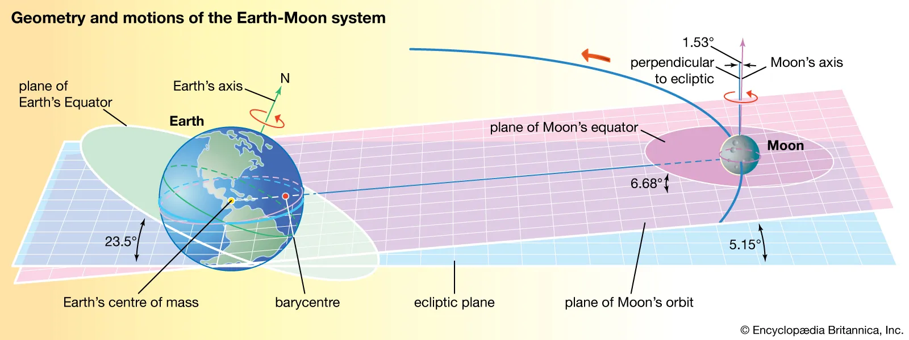

Slide 19
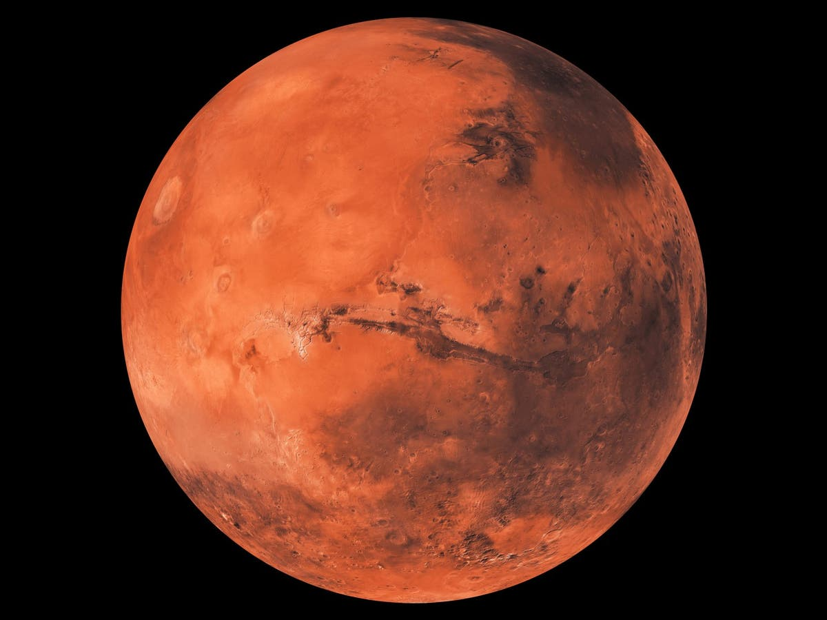
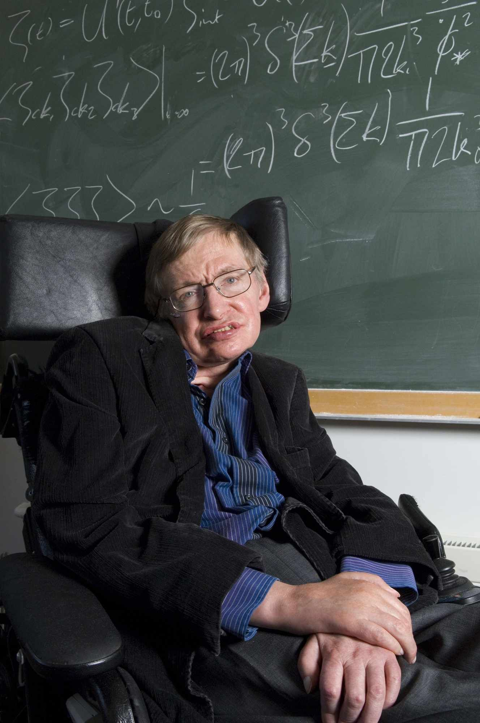
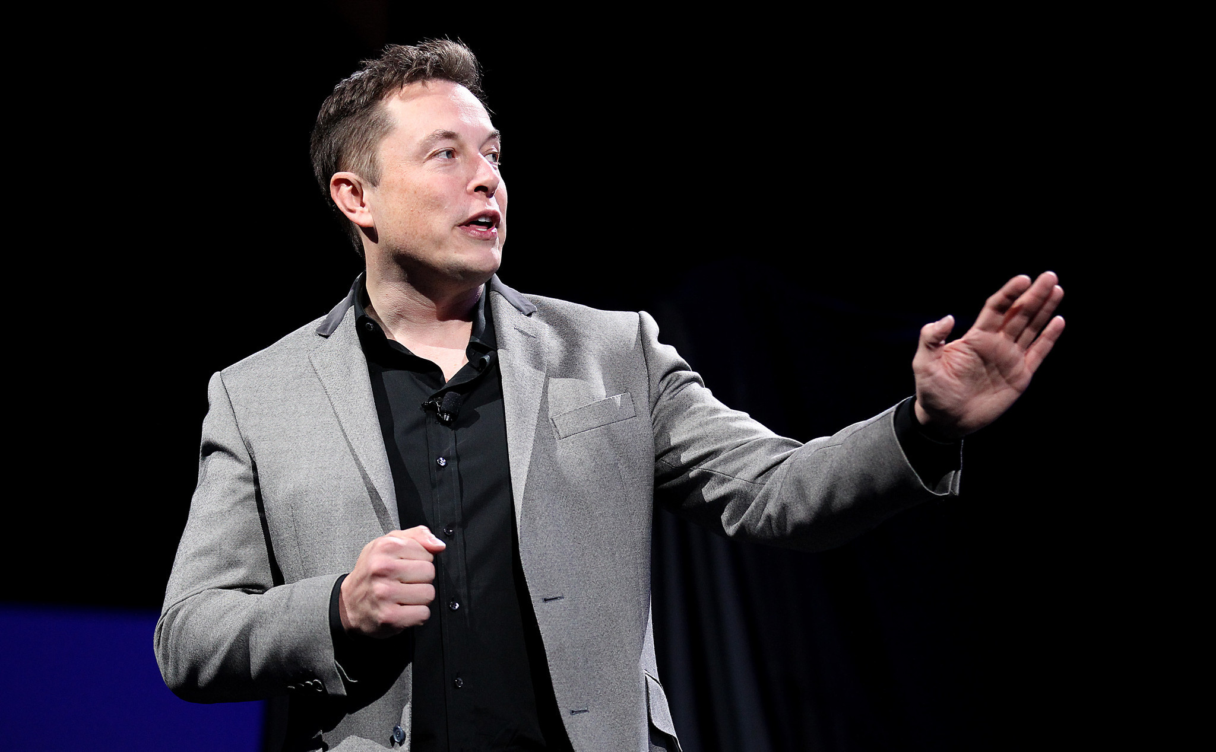

Slide 20

Little twin with 2 moons (phobos & deimos); 6,779km of diameter.
2,29,00,000 km from sun with orbital speed 24.077km/s.
Gravity acceleration is 3.7m/s².
Temp: -130ºC to 27ºC.
Day length of 24hr 37min; Year length 687 Earth days.
Atmosphere : 95% CO2, nitrogen 2%, argon 2%.
Seasonal change.

Slide 21
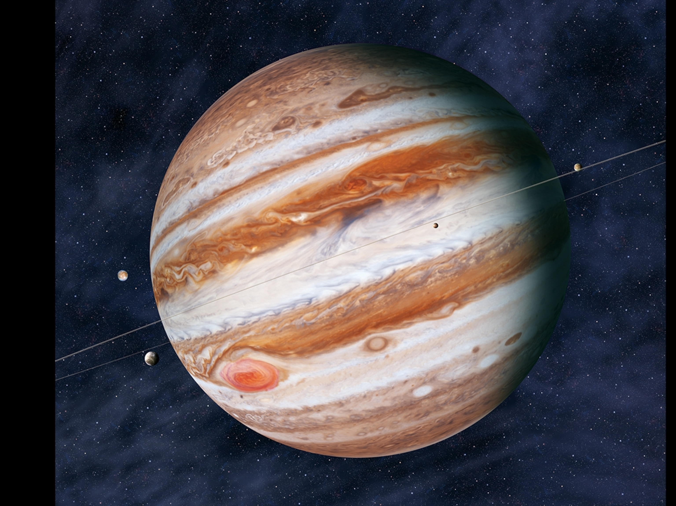

Slide 22
Largest of all; Gravity of 24.79m/s².
Diameter of 1,39,322km. 77,13,00,000 km away from sun.
Temp: -145ºC to 21ºC.
Over 200 moons only 67 are named.
Fourth brightest object to us.
Orbital period of 11.86 earth years at speed of 13.07km/s.
Day length of 9hr 56min.
Atmosphere: 89.9% hydrogen 10.2% helium.

Slide 23

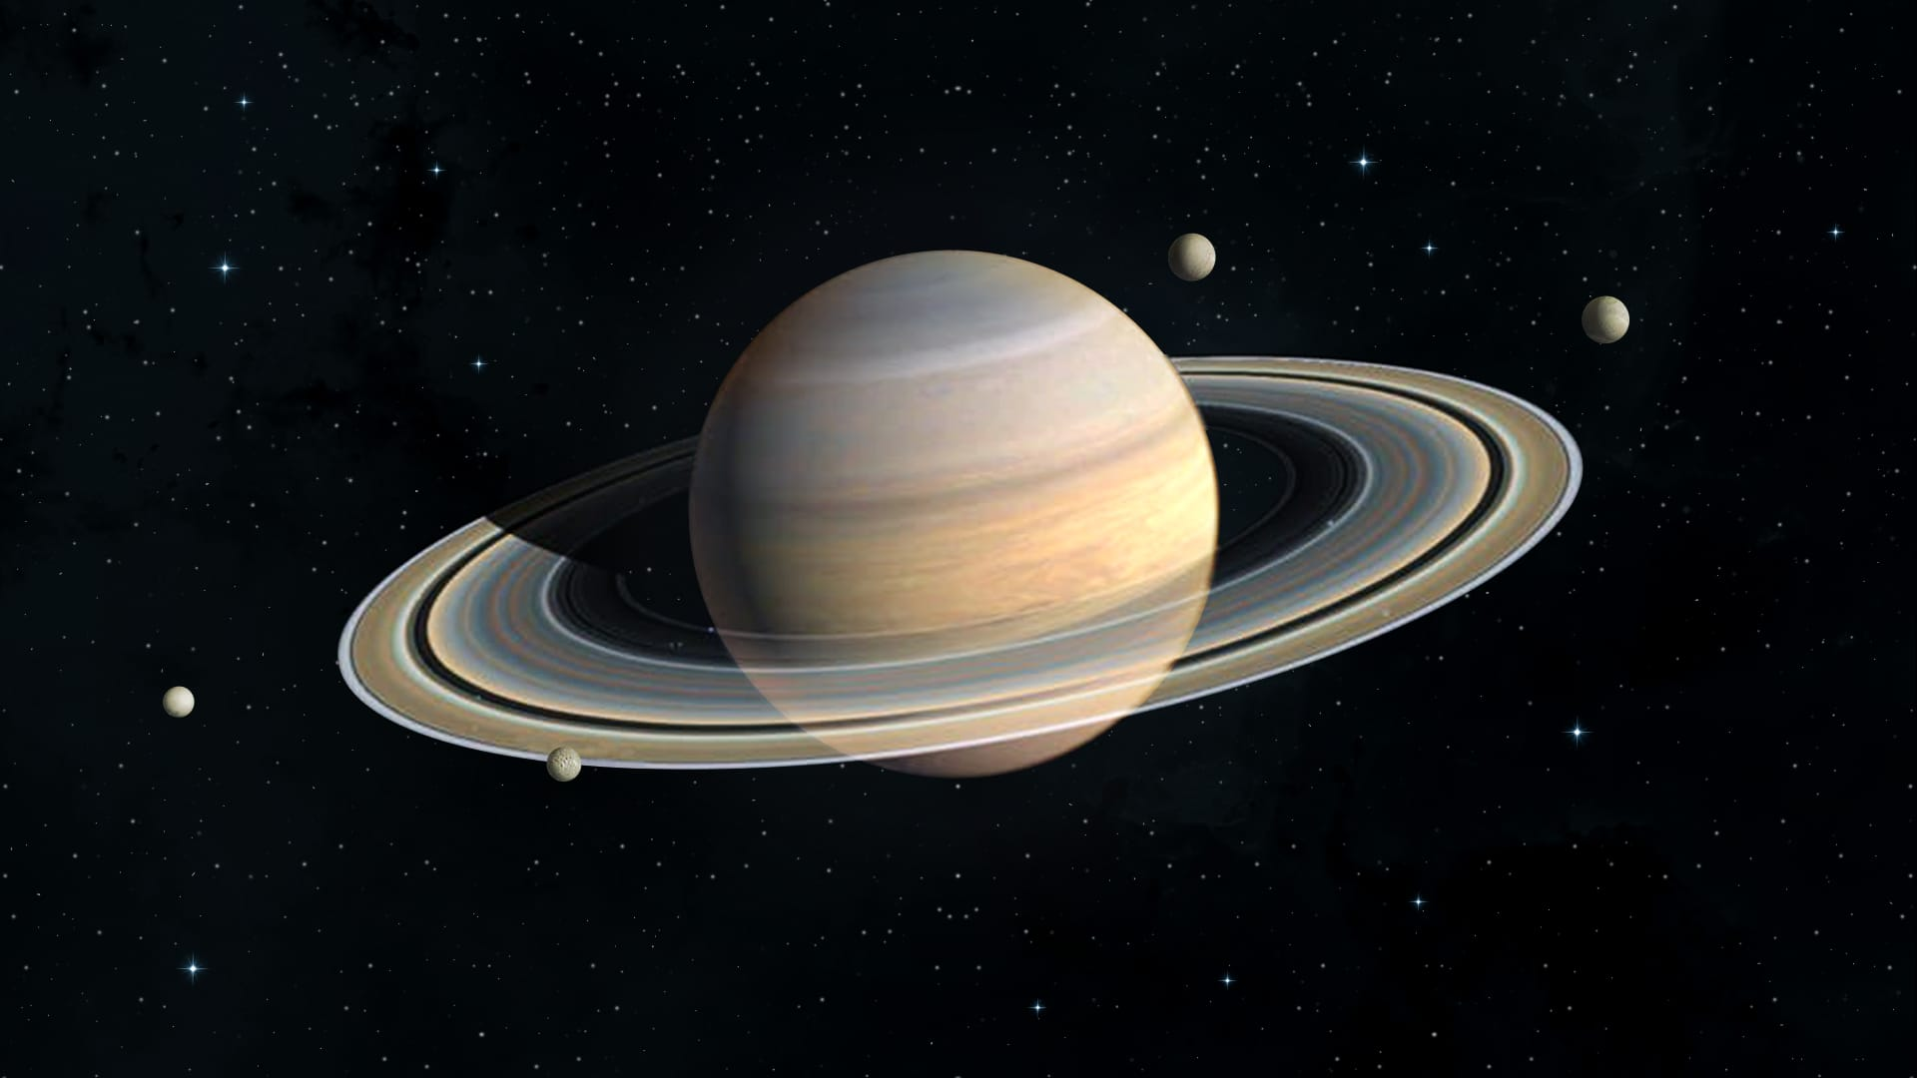

Slide 24

Second largest of 1,20,536km diameter;
Gravity of 10.44 m/s².
14,30,20,000 away from sun.
Orbital period 29years at speed of 9.68km/s.
Day length of 10hr 34min.
At least 145 moons confirmed.
7 main rings.
Atmosphere: 96% hydrogen, 3% helium.
Temp: -139ºC.
Life possible on some of it’s moons.

Slide 25
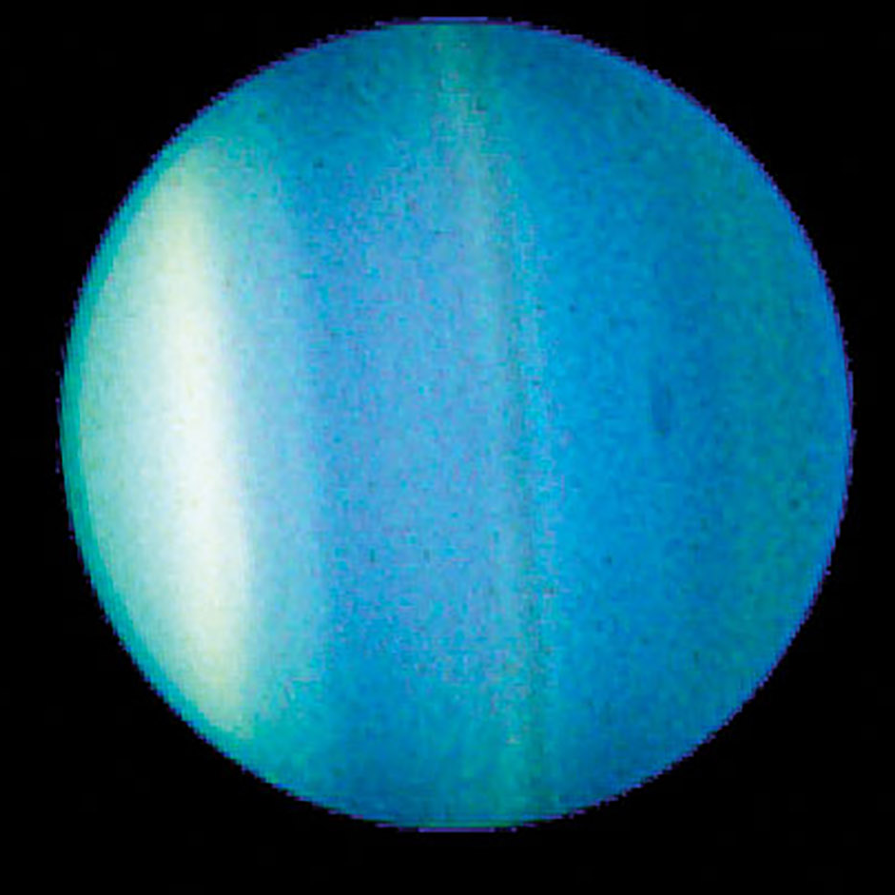

Slide 26

Third largest of 51,118km diameter.
Gravity acceleration is of 8.69m/s².
Sunlight takes 2hr 40min to reach as 19 AU distance.
Day length 17hr. orbit period of 84 earth years at 6.8km/s.
28 moons; 13 rings.
Temp: -224ºC.
Atmosphere: 83% hydrogen, 15% helium, 2% methane.
Unusual Magnetic field tilt at 60º

Slide 27
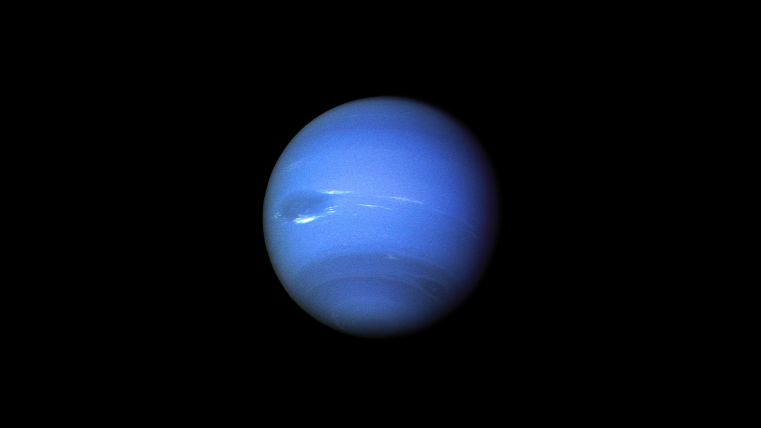
Math Explore

Slide 28
Diameter of 49,244km.
30AU from sun. Sun light takes 4hr to reach.
Gravity acceleration is of 11.15m/s².
Day length of 16hr; Orbital period of 165 earth years at 5.43km/s.
Temp: -2000ºC.
16 moons; 9 rings.
Atmosphere : 80% hydrogen, 19% helium, 1.5% methane.
Strong magnetic field.

Slide 29
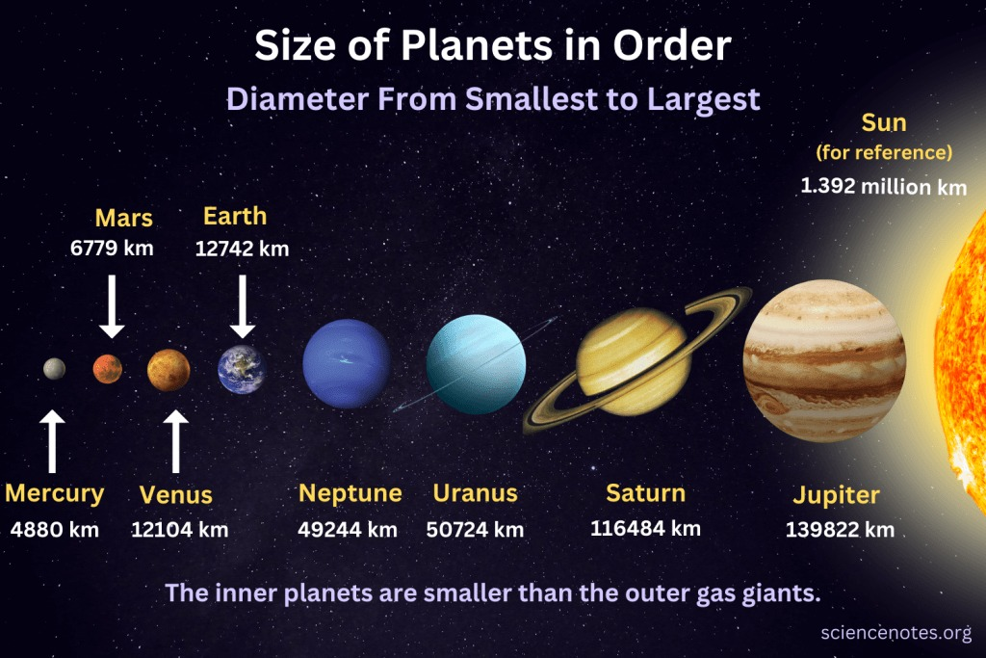

Slide 30
According to International Astronomical Unit planet possess
Orbit around its host star.
Be mostly round.
Be big enough that its gravity cleared away any other objects in it path.

Slide 31
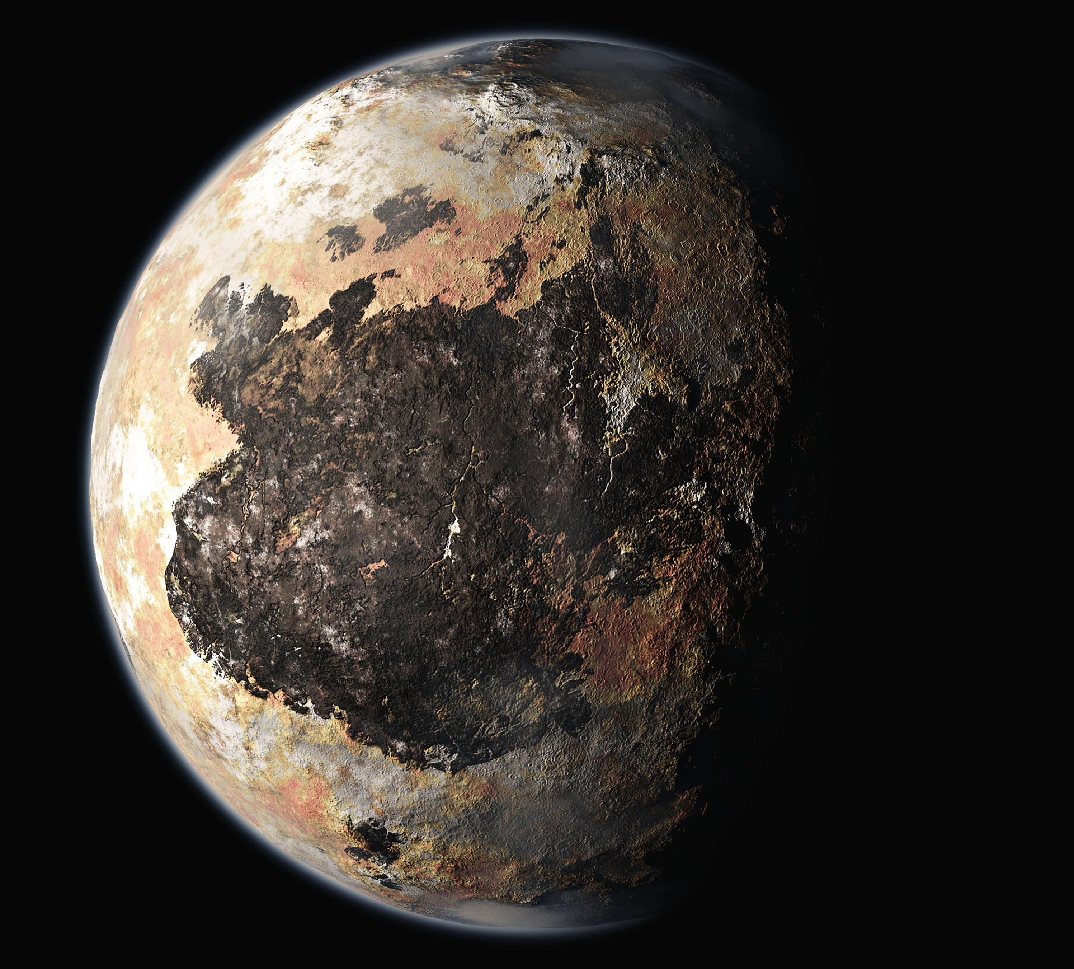
Forgotten One’s

Slide 32
Diameter of 2,377km.
5 moons.
Orbital period of 248 earth years and rotation of 6.4 earth days.

Slide 33
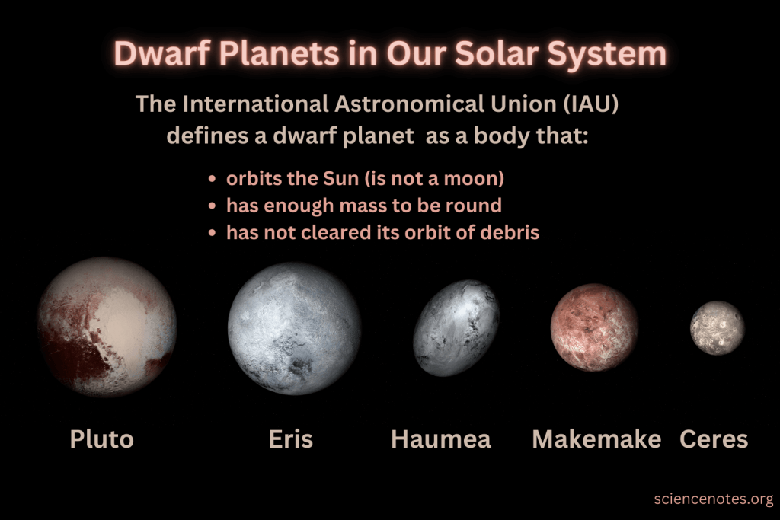

Slide 34
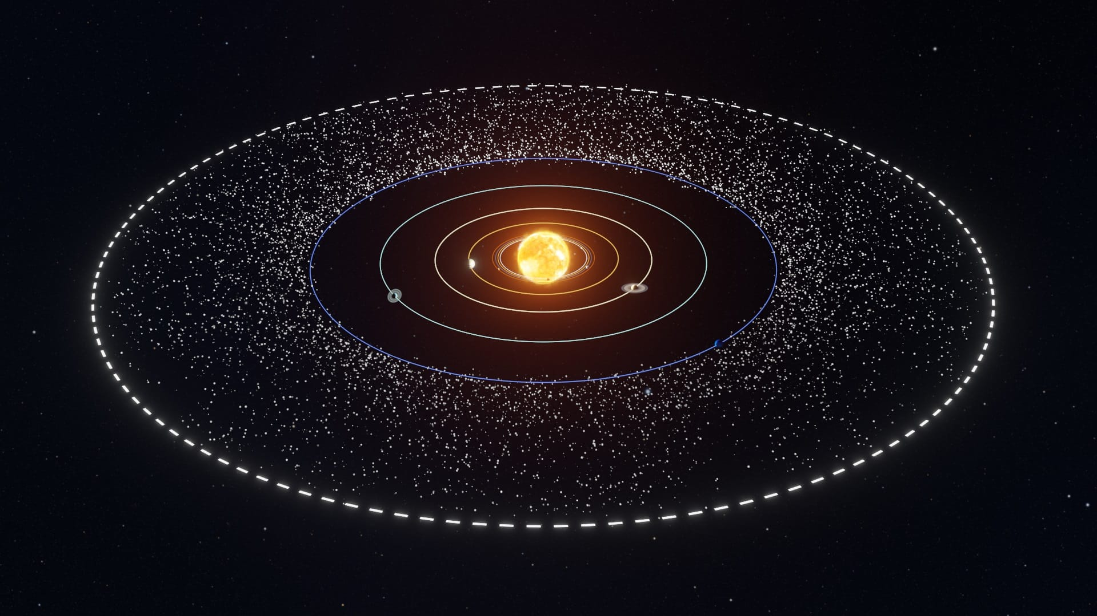
Ice Wall

Slide 35
Belt of icy objects
Dwarf planet, ice stone, frozen compounds of ammonia & methane.
30AU from sun; wider around 20AU.

Slide 36
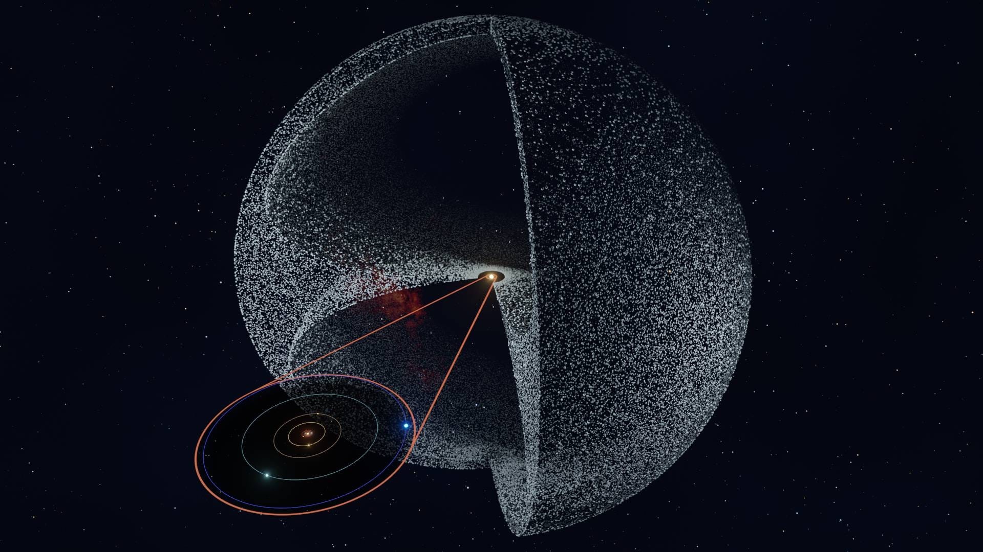
Oyster Shell

Slide 37

Comet originates.
2000AU from sun.
Made of ice object and dust and asteroids.

Slide 38
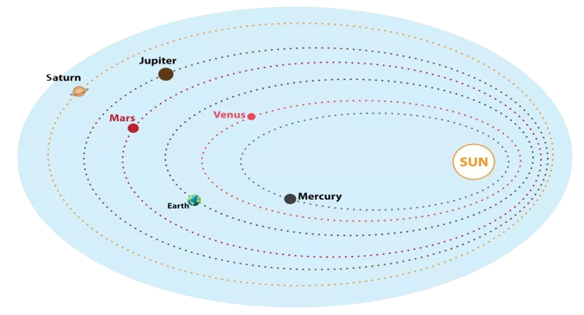
Orbit

Slide 39
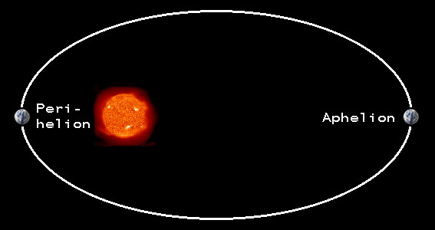

Slide 40
Mostly planets orbit in elliptical.
Maintained by gravitational pull & velocity.
Inertia prevent from falling towards star.
Planet possess kinetic energy due it’s motion & potential energy due to it’s position.
Closer to sun potential energy decrease and kinetic energy increase; higher angular momentum
Far away to sun potential energy increase and kinetic energy decrease; lower angular momentum.

Slide 41
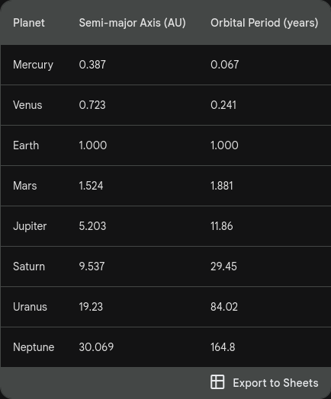

Slide 42
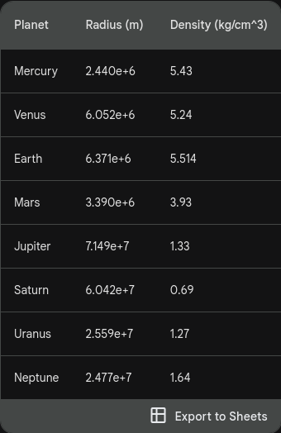

Slide 43
Thank You

